Slide 1


Python Flask –
Click Event Processing

Slide 2
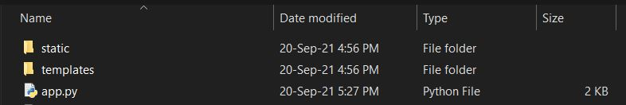
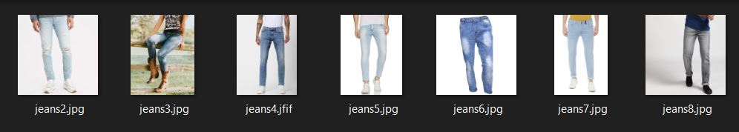
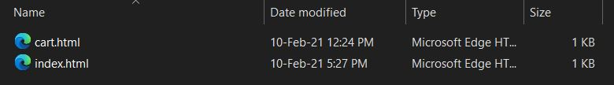
Flask Folder
Flask
Folder: static
Install Flask <pip install flask>
Create a python file
Create a folder <templates >
--> Holds html files
Create a folder <static>
--> Holds image files
Folder: templates

Slide 3
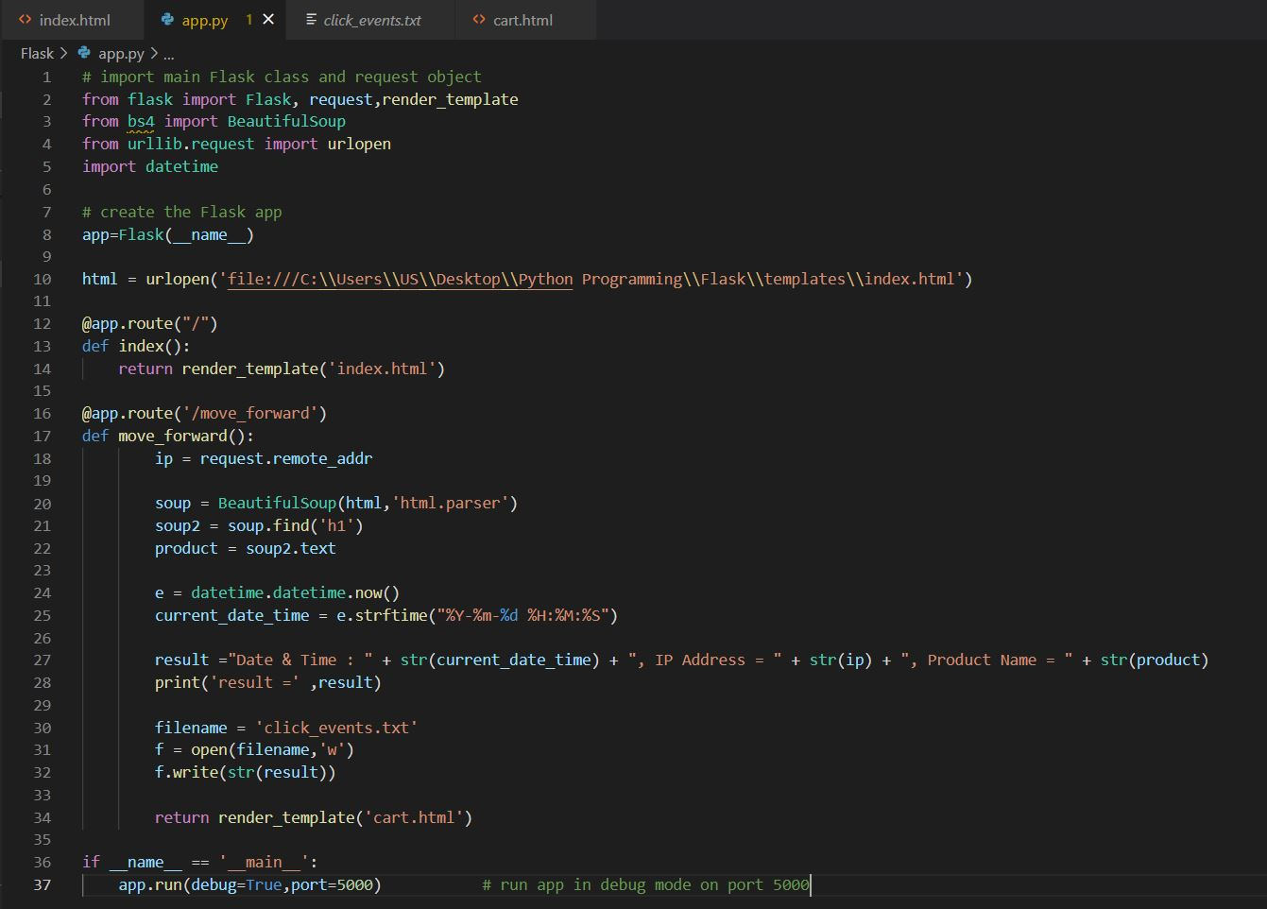
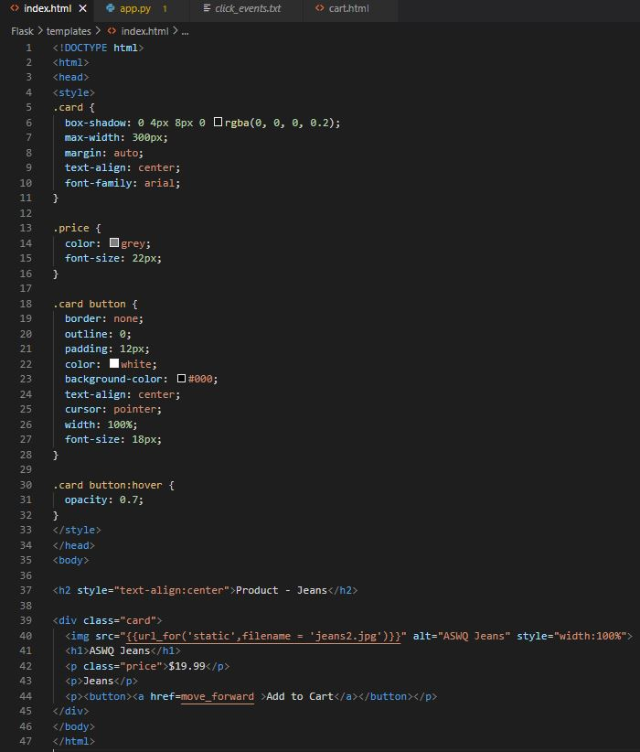
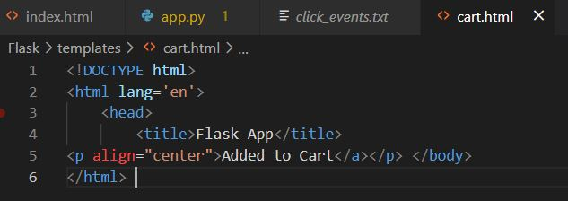
Snippets

Slide 4
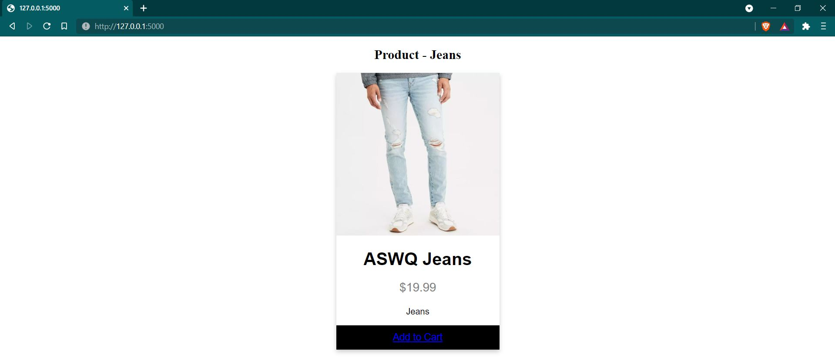
Output:
Line 12 : @app.route("\")
index.html file loaded
Line 16 : @app.route("\move_forward")
demo2.html file loaded

Slide 5
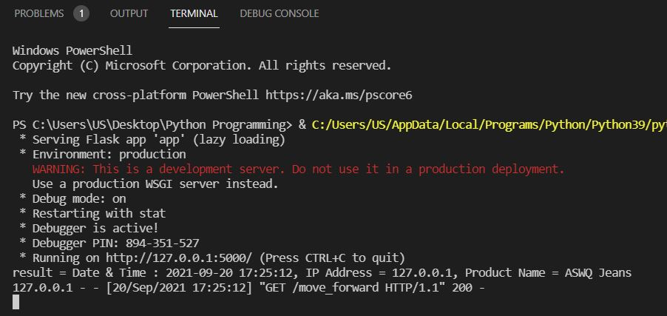
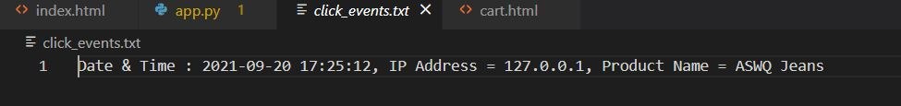
Terminal View -->
Result: click_events.txt -->

